Slide 1

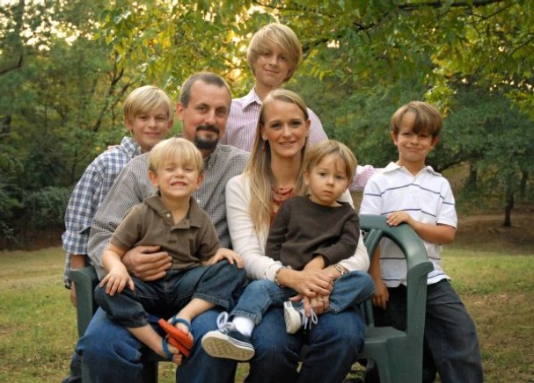


Demographic Segment Summary
Affluent Families
Avg. American Families
Average Families
18%
“Get it Done Dave”
36%
“Last Minute Larry”
38%
Predominantly married with children in middle income brackets
Mature, professional families
With high Income and education
Older and married couples
in rural areas
with moderate income
Generational Families
Young Diversity
24%
“Traditionalist Trudy”
22%
“Savvy Sally”
Older, less educated and more rural families with grandchildren
Young singles and families working to improve their lives

Slide 2
Affluent Families – “Get it Done Dave”
Affluent Families (18%)
Summary
Married with children
Middle age (40-60s)
High income (>100k)
Family of 3-4
Mgmt professionals
Single family Homes in suburban areas
85% White with little ethnic diversity
Overview
Mature, professional families
With high Income and education
Product Usage
87% of Life Policies are Term
Attrition lowest of all segments
69% over $200k FV for Life
Size of Segment
Customers: 18% of customer base
31% of Life Insurance Customers
Behavioral Preferences
Bank Draft Customer
Dis-engaged but responsible
Make payments as efficient as possible

Slide 3
Generational Families – “Traditionalist Trudy”
Generational Families (24%)
Summary
Married – often with grandchildren
Older age (50-70s)
Medium income ($50-$99k)
Family of 3-4
83% did not complete college
Single family Homes in smaller towns
Predominantly White - little ethnic diversity
Overview
Older, less educated and more rural families with grandchildren
Product Usage
25% of Life is UL/WL
Attrition is better than average
Tend to have lower FV Life
Size of Segment
Customers: 24% of customer base
23% of Life Insurance Customers
Behavioral Preferences
Fixed income, wants control
Pays via phone or direct bill
Likes the routine of payments

Slide 4
Average Families – “Last Minute Larry”
Average Families (36%)
Summary
c
Married – often with children
Range of ages over 30
Range of income mostly below $100k
Family of 3-4
Mix of education
Predominantly White - little ethnic diversity
Overview
Predominantly married with children in middle income brackets
Product Usage
Average product mix
Attrition is below average
Range of FV aligned with average
Size of Segment
Customers: 36% of customer base
34% of Life Insurance Customers
Behavioral Preferences
Busy with work and family
Dis-engaged with policy and how it works
Knows paying premium is important, but doesn’t have a routine

Slide 5
Young Diversity – “Savvy Sally”
Young Diversity (22%)
Summary
Often single – or young married
Younger group – most below 55, many in 20’s and 30’s
Lower income (50% below $50k)
Family of 1-3
50% no college / 50% some/completed college
Most diverse ethnicity with 36% not white
Overview
Young singles and families working to improve their lives
Product Usage
32% of Life is UL/WL – most of any group
Attrition is worst of any group (14% below average)
51% of Life FV is below $100k – lowest group
Size of Segment
Customers: 22% of customer base
11% of Life Insurance Customers
29% of Other Customers
Behavioral Preferences
Expects to pay premium online
Limited income, wants control
Knows policy is important for growing family

